Slide 1
Sales & Multiplication migration to industry system
Presenter: EMILIANO PABLO “VACANCY” ESTEVEZ

Slide 2
Summary
Sales & Multiplication POC and Infrastructure setup - Estimation plan
Sales & Multiplication Migration – Estimation plan
Sales & Multiplication - POC & Migration dependencies plan
The total estimation plan for Sales & Multiplication Infrastructure setup and Migration is 17 sprints of 6 members team.
Estimation & Migration plan does not include ISO and Cloud ops security controls setup and Ownership transition

Slide 3
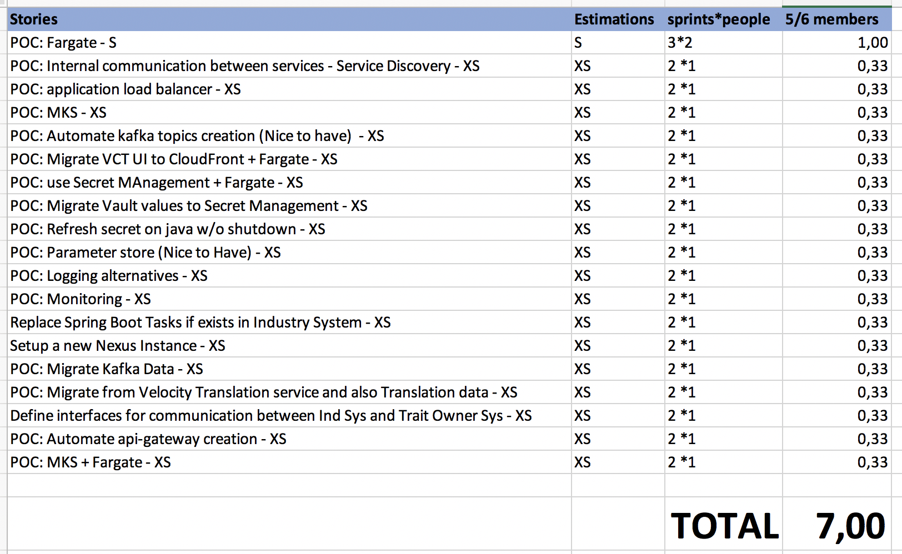
Sales & Multiplication - POCs & Infrastructure setup
Team of 6 members estimation plan is 7 sprints.

Slide 4
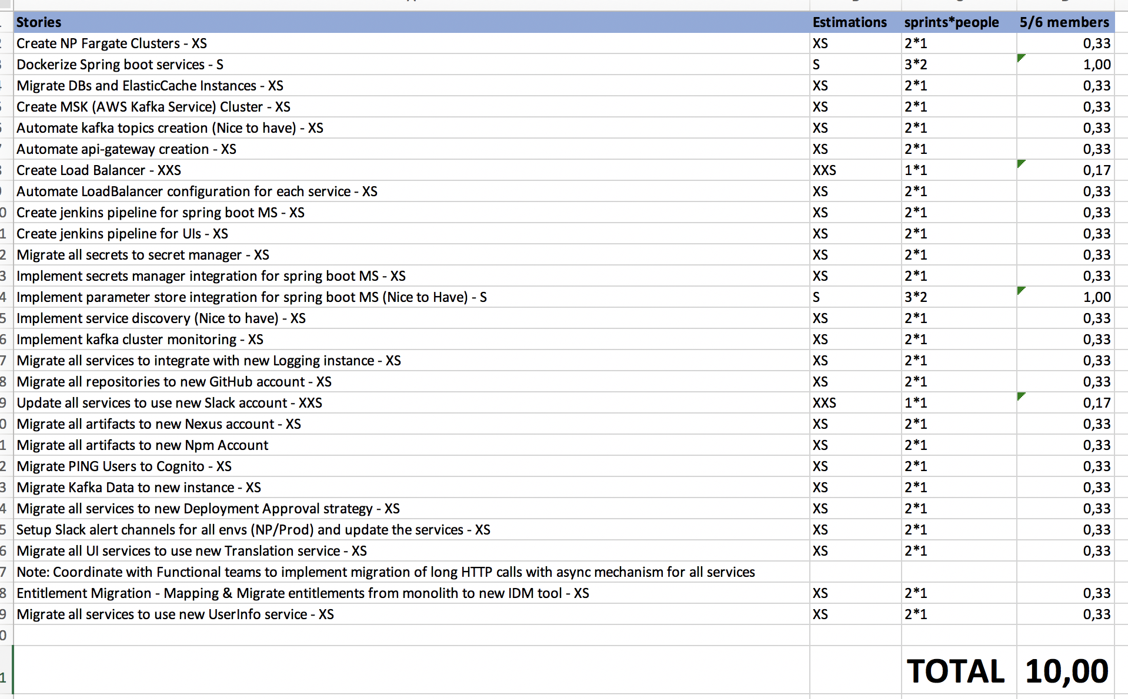
Sales & Multiplication – Migration plan
Team of 6 members estimation plan is 10 sprints.

Slide 5
Sales & Multiplication – Tasks dependencies
Excel file
https://monsanto365-my.sharepoint.com/:x:/r/personal/fferr10_monsanto_com/_layouts/15/Doc.aspx?sourcedoc=%7Bccbcf1e8-adca-46ba-afff-8c3315af5882%7D&action=default&cid=e28b2d6c-033b-4114-aab8-e90e0648c6c5

